Slide 1
MULTIMOADAL TRANSFORMER FOR UNALIGNED MULTIMODAL LAGUAGE SEQUENCES
2021.08.12 REVIEW

Slide 2
CONTENTS
INTRODUCTION
RELATED WORKS
PROPOSED METHOD : Multimodal Transformer (MulT)
EXPERIMENT

Slide 3
INTRODUCTION
- multimodal : language, vision, audio
- issue
1) inherent data non-alignment due to variable sampling rates for the sequences from each modality
2) long-range dependencies between elements across modalities
- propose : Multimodal Transformer (MultT)

Slide 4
RELATED WORKS
1) Human multimodal language analysis
2) Transformer Network

Slide 5
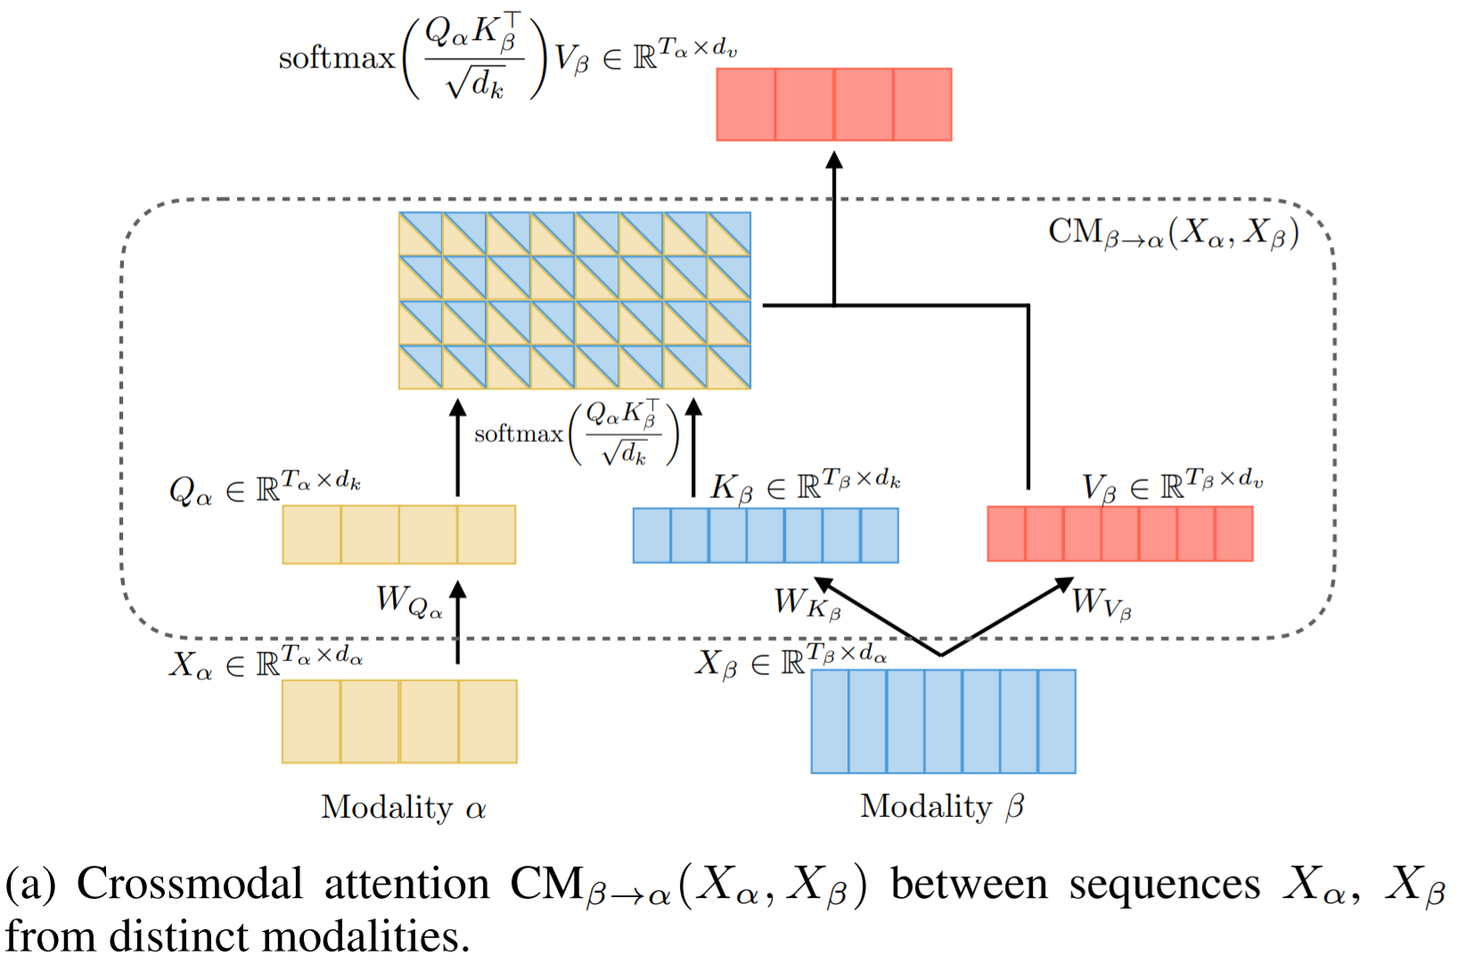
PROPOSED METHOD
- crossmodal attention

Slide 6
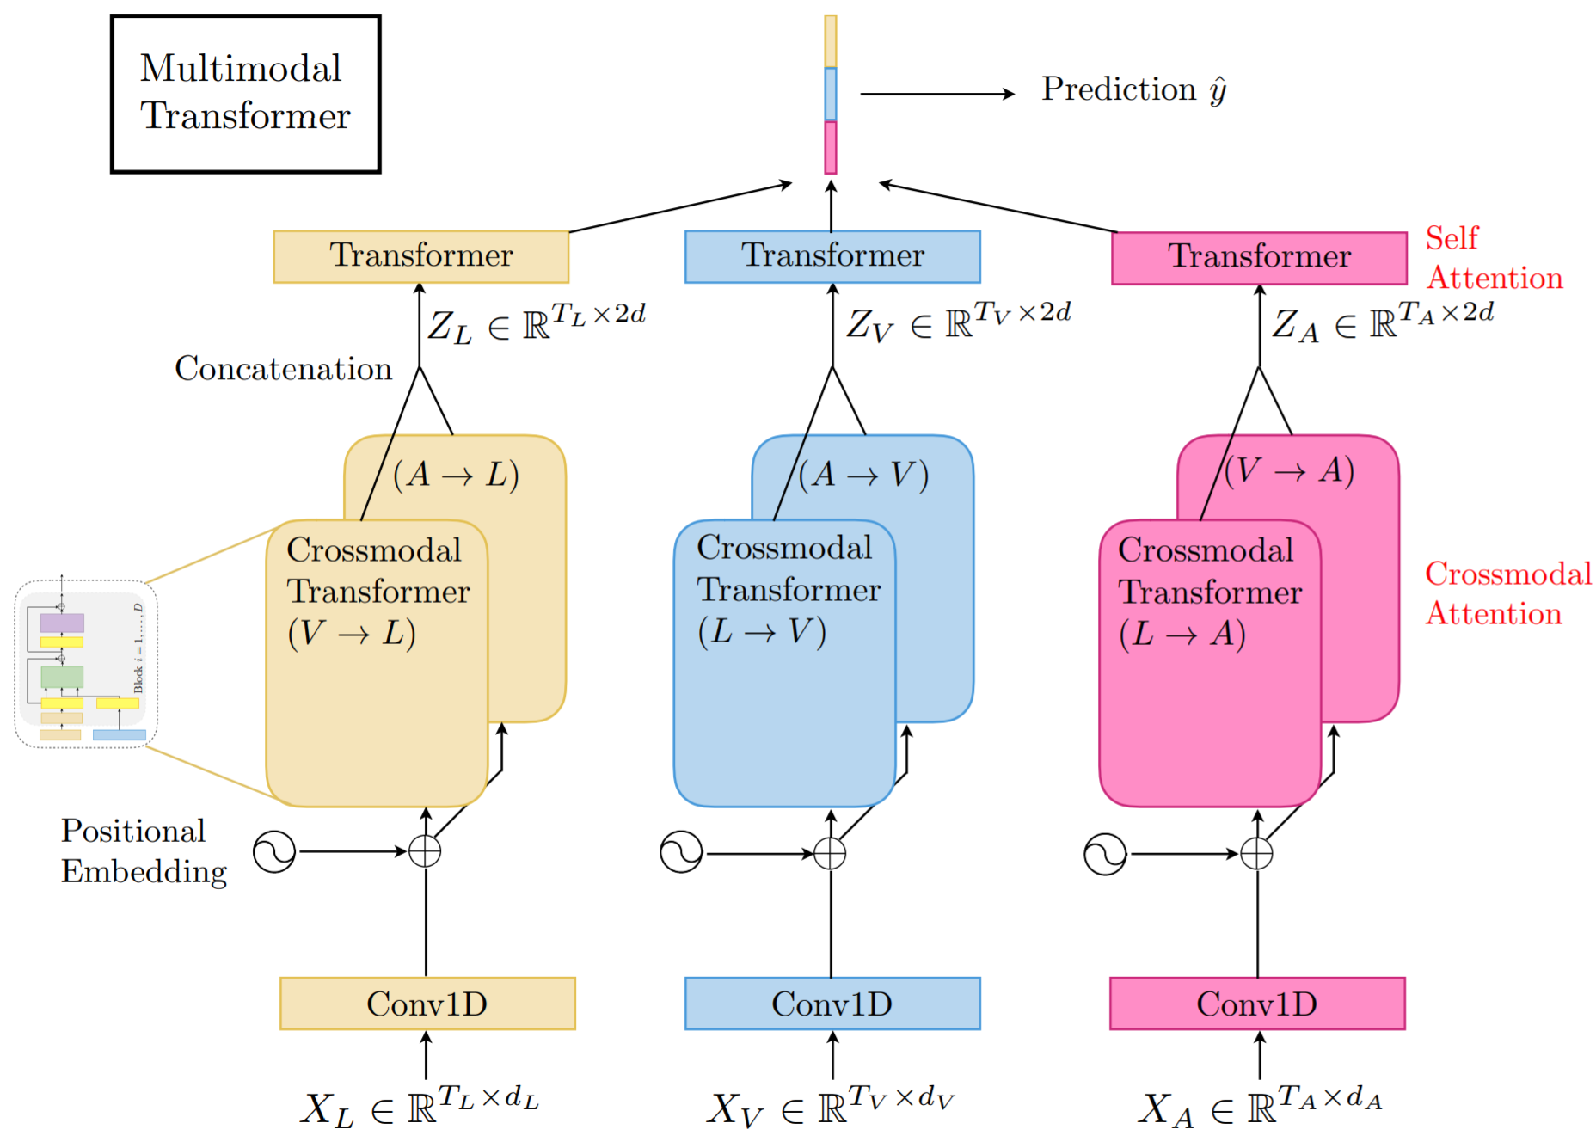
PROPOSED METHOD

Slide 7
PROPSOED METHOD (1) temporal convolution (CONV1D)
- contain the local structure of the sequence
- poject to the same dimension d

Slide 8
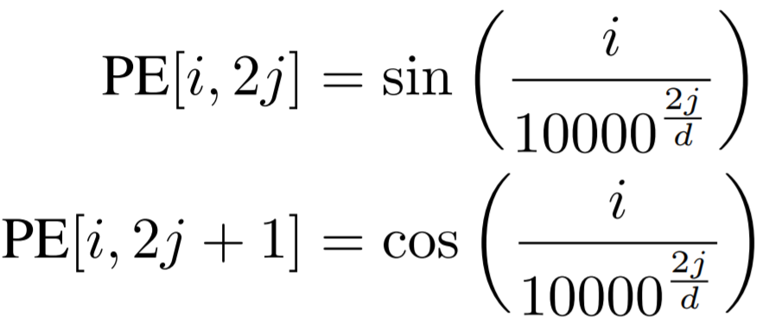
PROPSOED METHOD (2) Positional embedding

Slide 9
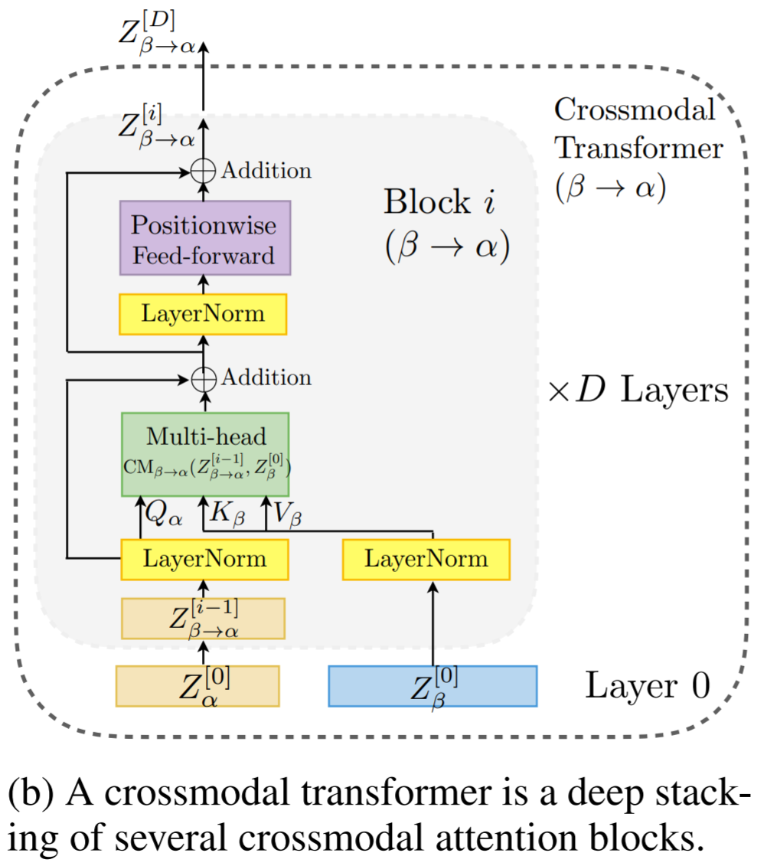
PROPOSED METHOD (3) Crossmodal Transformers

Slide 10
PROPOSED METHOD (4) Self-Attention Transformers and Prediction

Slide 11
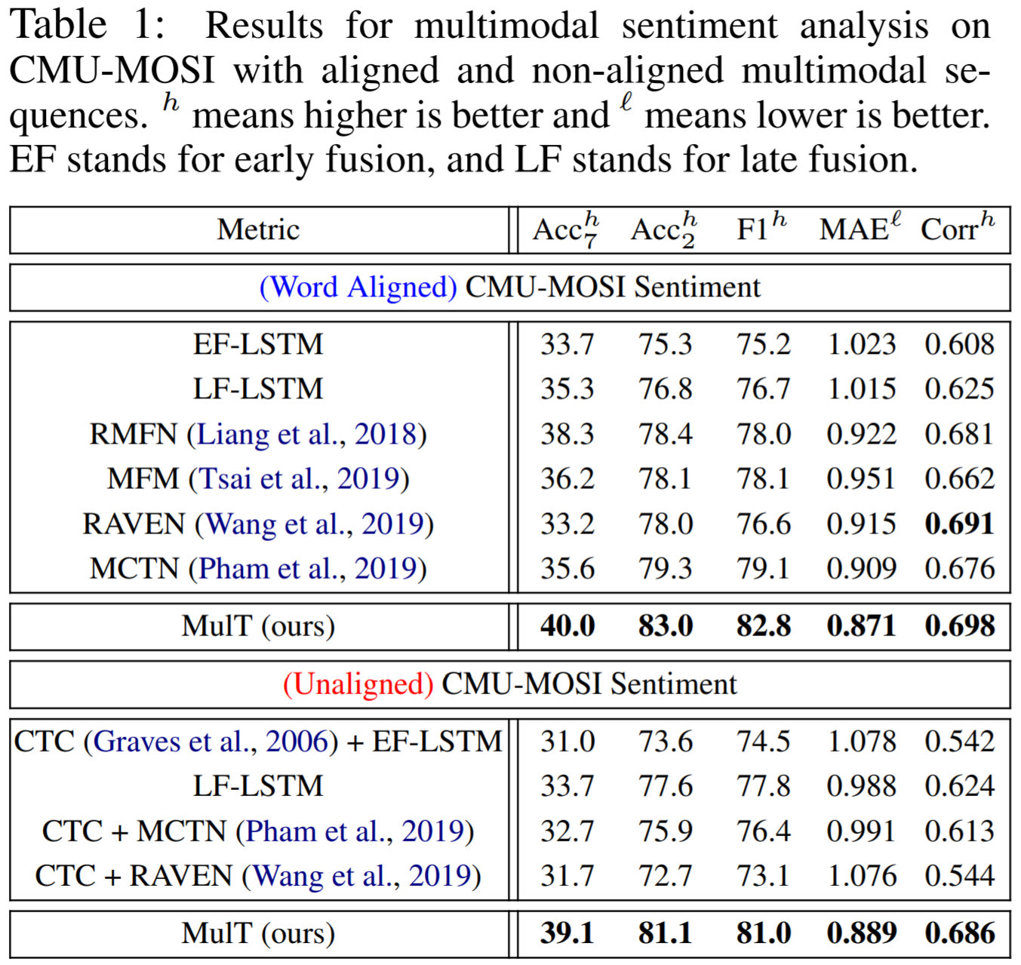
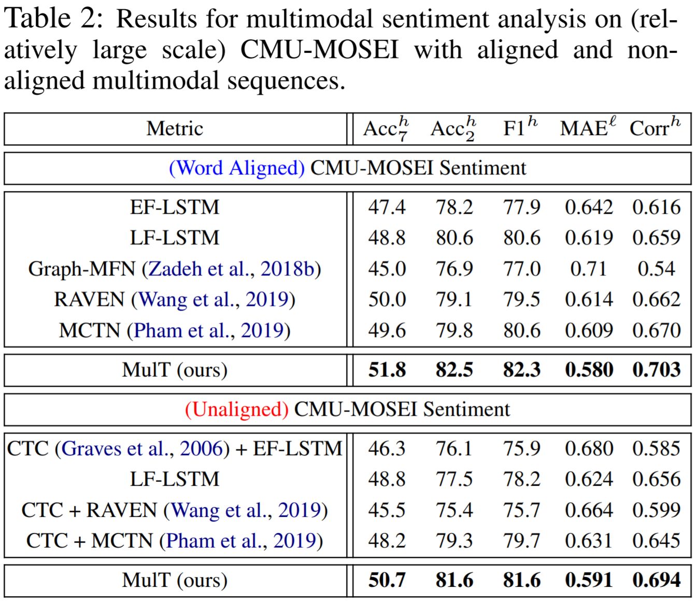
EXPERIMENT

Slide 12
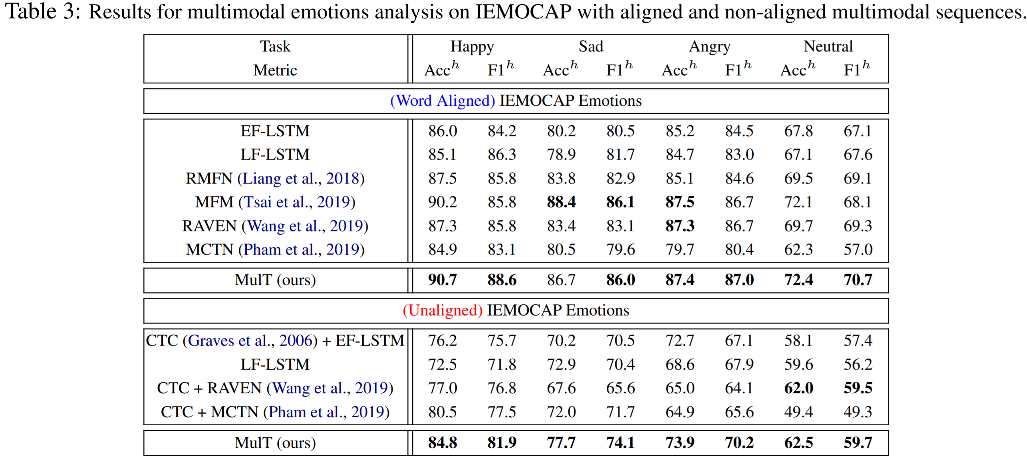
EXPERIMENT

Slide 13
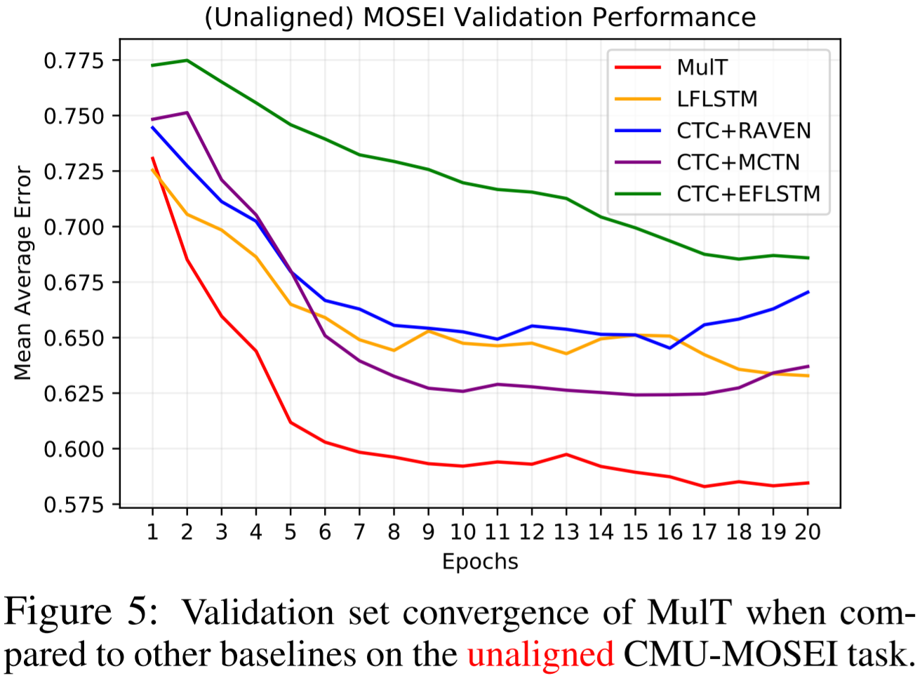
EXPERIMENT

Slide 14
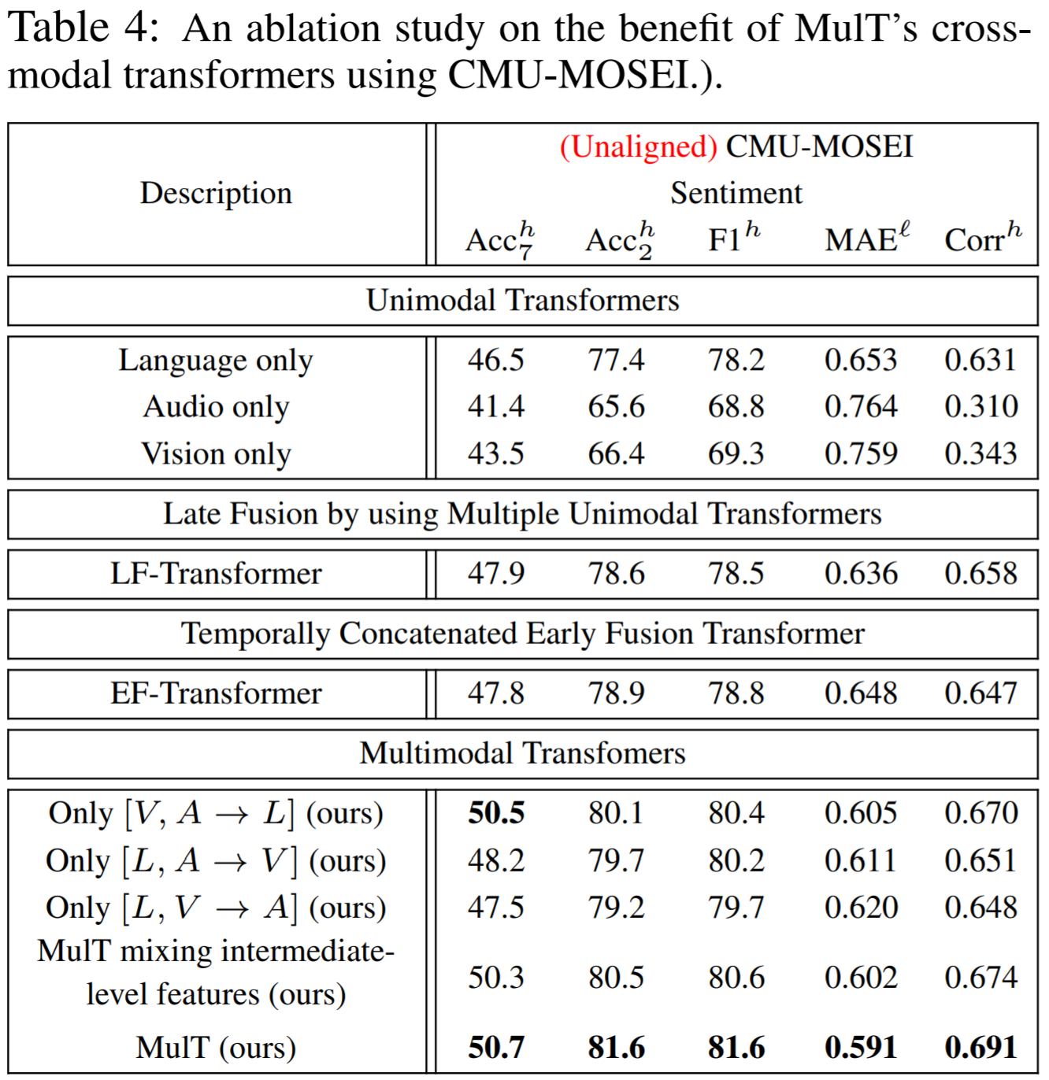
EXPERIMENT

Slide 15
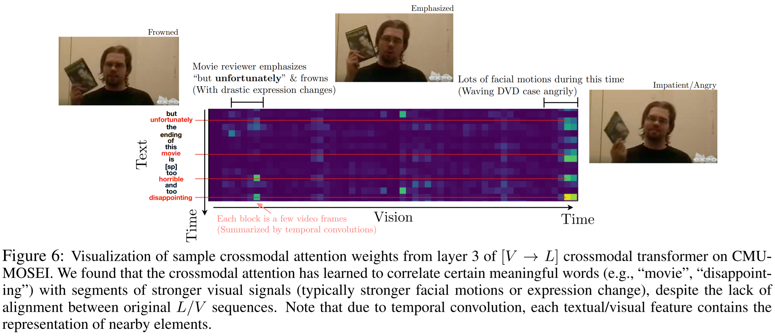
EXPERIMENT

